Slide 1
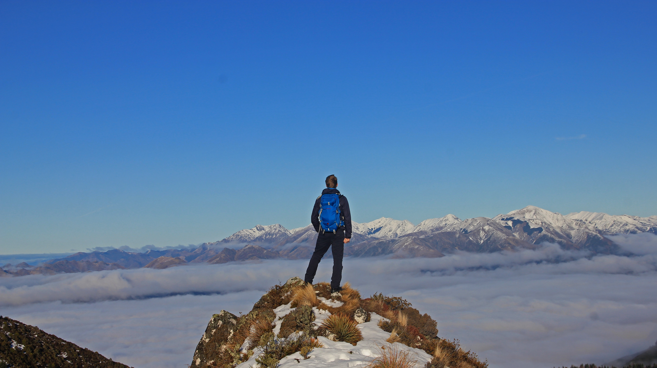

Conquer the world.
Plan your campaign today.
Notes:
Jan

Slide 2
Are you ready for (a) Perfect Time?
Perfect Time – Plan Your Trip
The planning tool for your perfect vacation

Slide 3
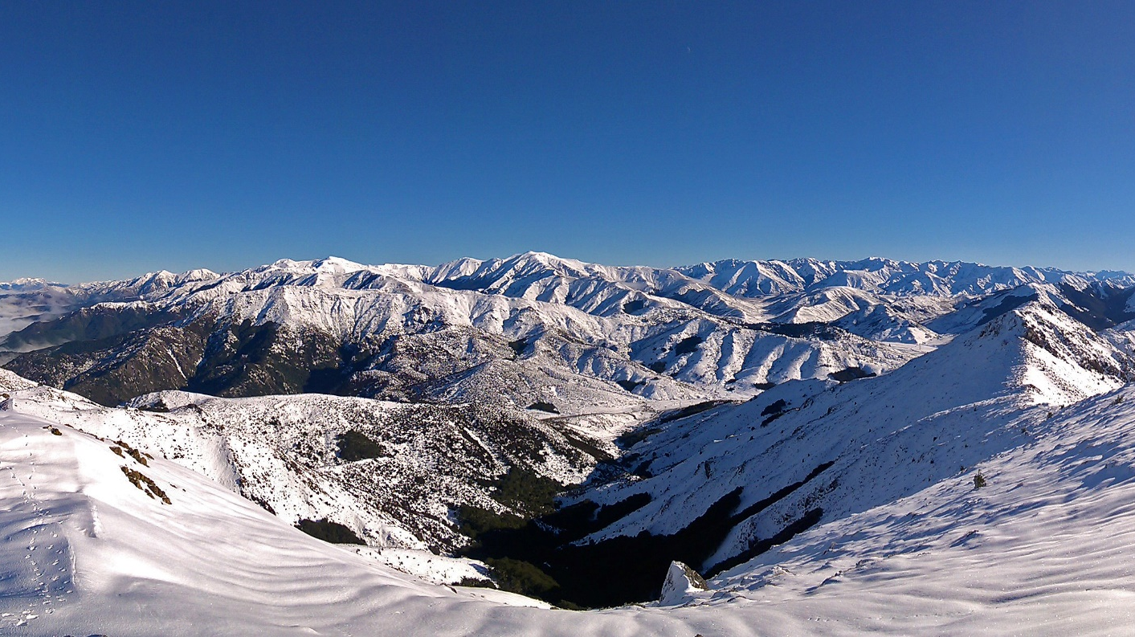
Stand on top of the world.
Plan your hike today.

Slide 4
What to expect?
What is Perfect Time?
Why would you use Perfect Time?
Who is creating Perfect Time? How does the team organize itself?
What is the foundation of Perfect Time?
How was Perfect Time designed?
How is quality promoted and enforced?
What is the current state of the project?

Slide 5
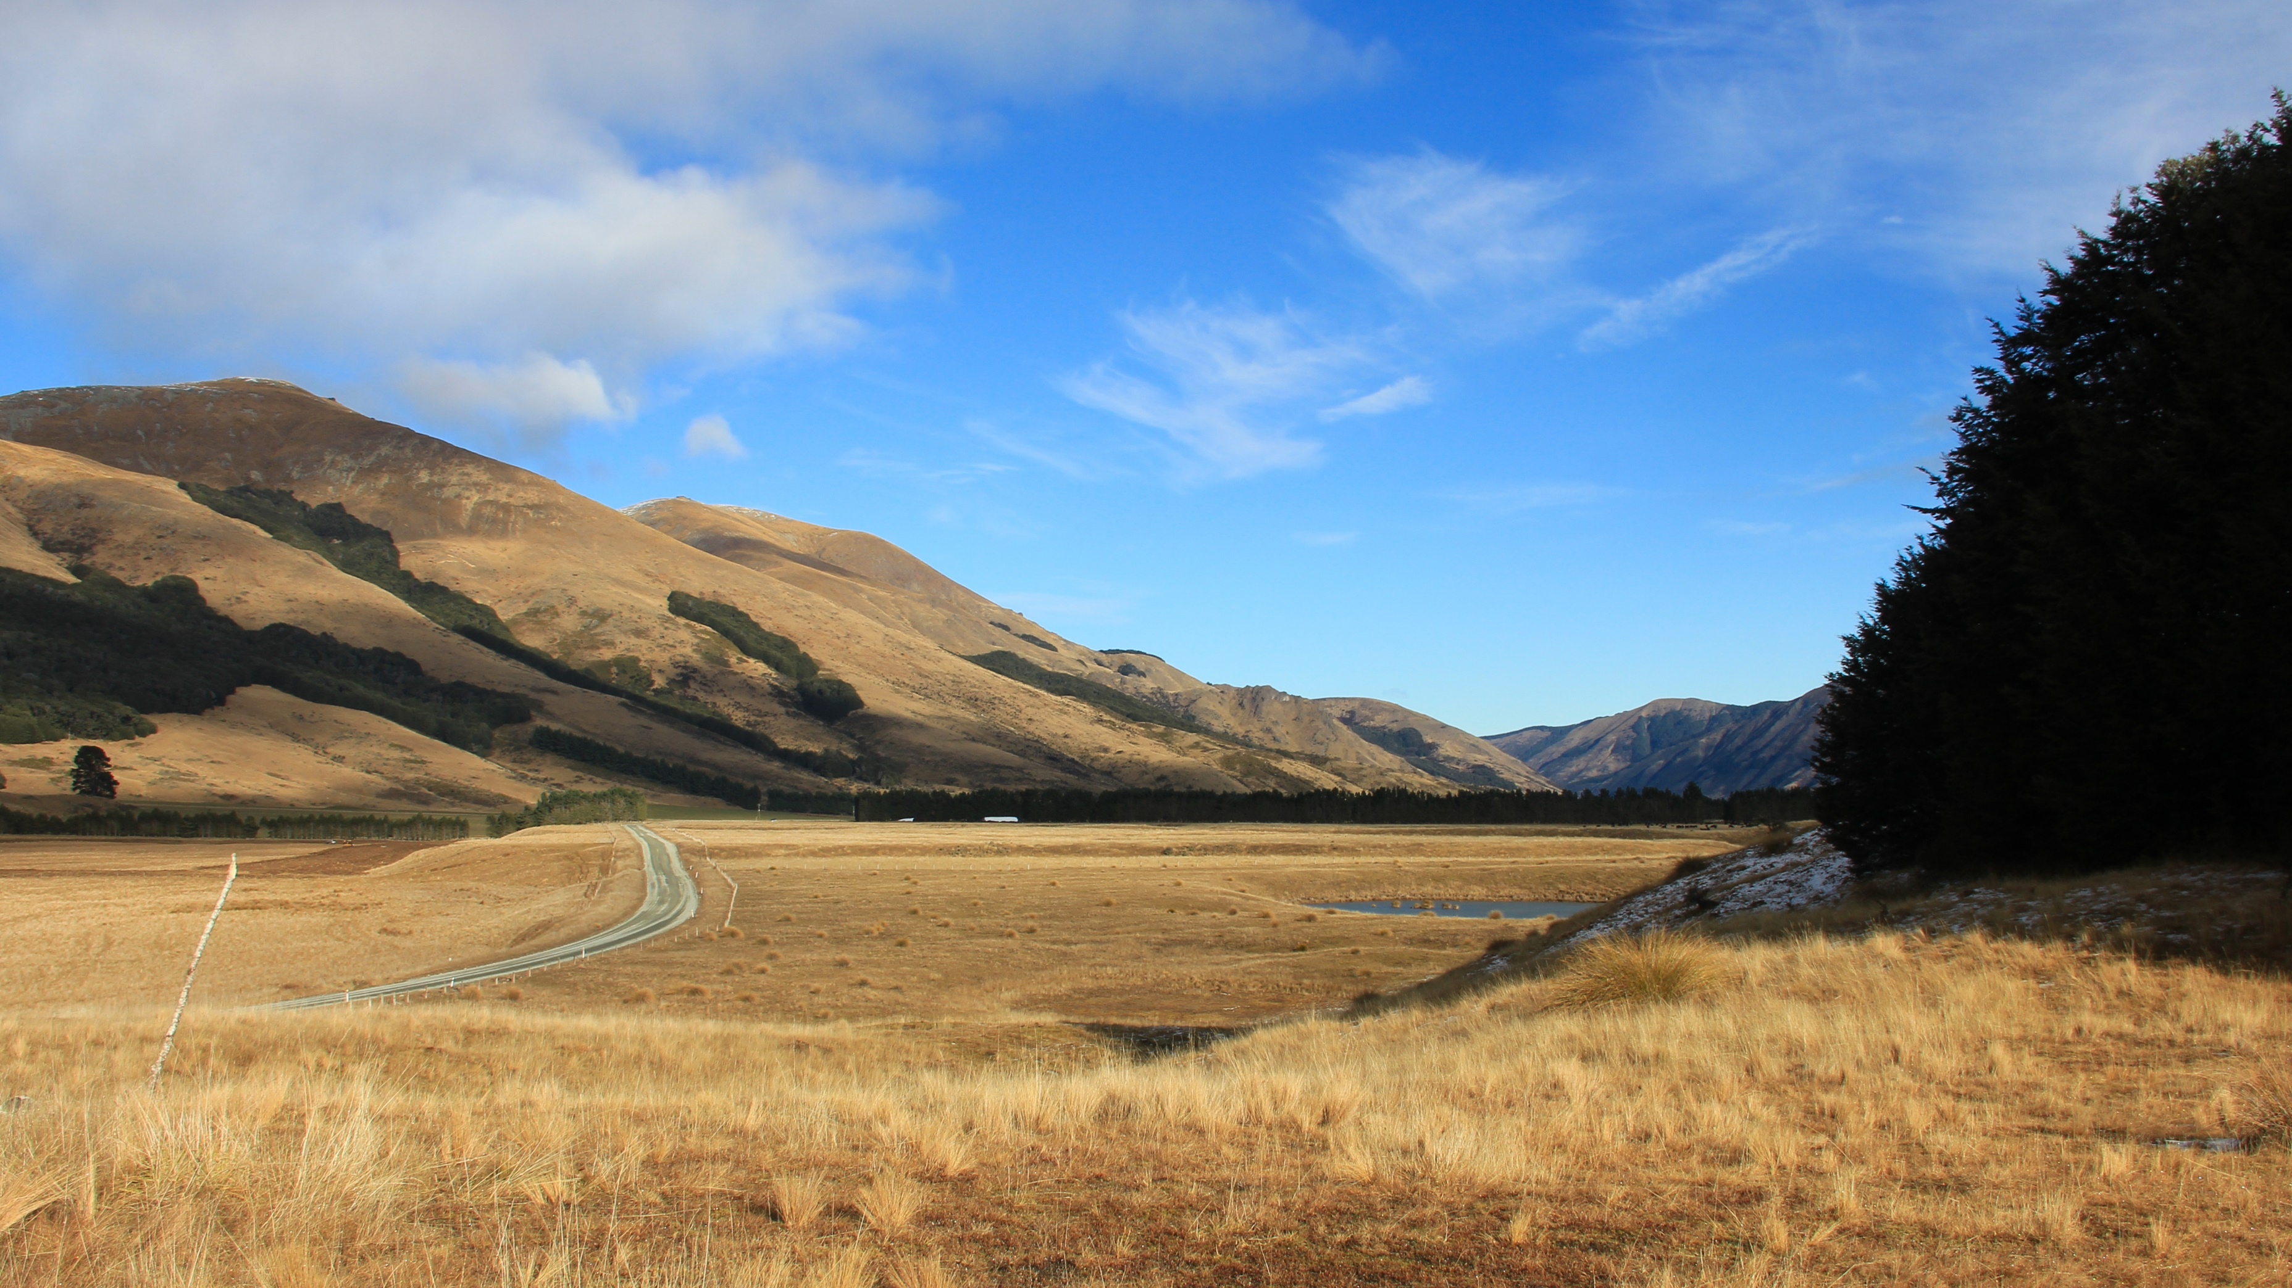
Fangorn
Follow Aragorn’s footsteps and search for the Hobbits.
Plan your trip to New Zealand – and Middle Earth.

Slide 6
What is Perfect Time? The vision and the idea
“Our vision is to create a web application that will allow you to plan your trip by setting different locations or stages. You will also be able to insert generic data for the whole vacation. After your holiday you can add a blog in the App using the already available data from planning your trip. Afterwards you can publish your trip and share it with your friends. They can use your plan as an outline for their own trip by simply importing your published data.”
Make planning your trip simple, flexible and intuitive
Make sharing your experiences easy
Allow using experience of those who came before you

Slide 7
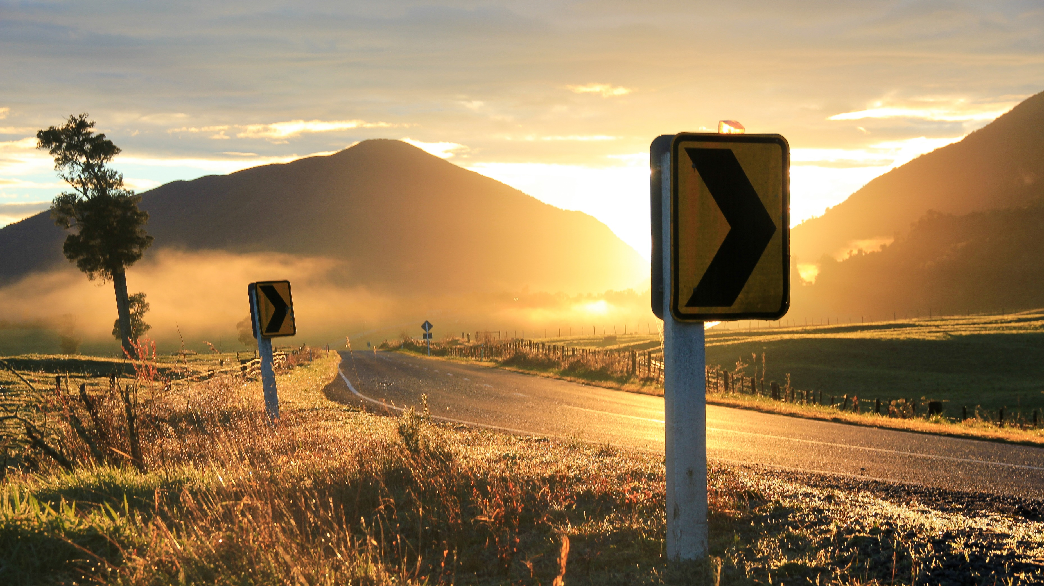
Plan your perfect sunrise.

Slide 8
Why would you use Perfect Time? The customer benefit
UVP, there is no other application with similar functionality
Running as a web application in any browser and on any device
Customizable by the user
Easy to monetize by advertising activities, location or even whole trips.
Cheap to maintain and easily scalable

Slide 9
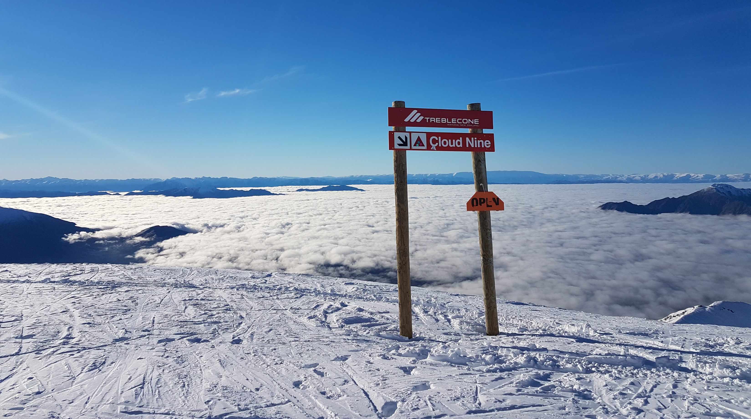
Plan your stay on Cloud Nine.
Notes:
Lukas

Slide 10
Who is creating Perfect Time? The team and the RUP roles
Jan: Systems Analyst, Tester
Lea: Business Process Analyst, Tester, Project Manager
Lukas: Software Architect, Tester, Deployment Manager
Tim: Integrator, Process Engineer

Slide 11
How does the team organize itself? Scrum and YouTrack
The project uses Scrum.
Agile -> Weeklong sprints
Clearly structured -> Swim lanes to organize tasks
Fast -> Breaking it down to small tasks
The progress can be accessed through our YouTrack account: https://perfecttime.myjetbrains.com/youtrack/agiles
We publish a weekly blog: https://perfecttime608150251.wordpress.com/

Slide 12
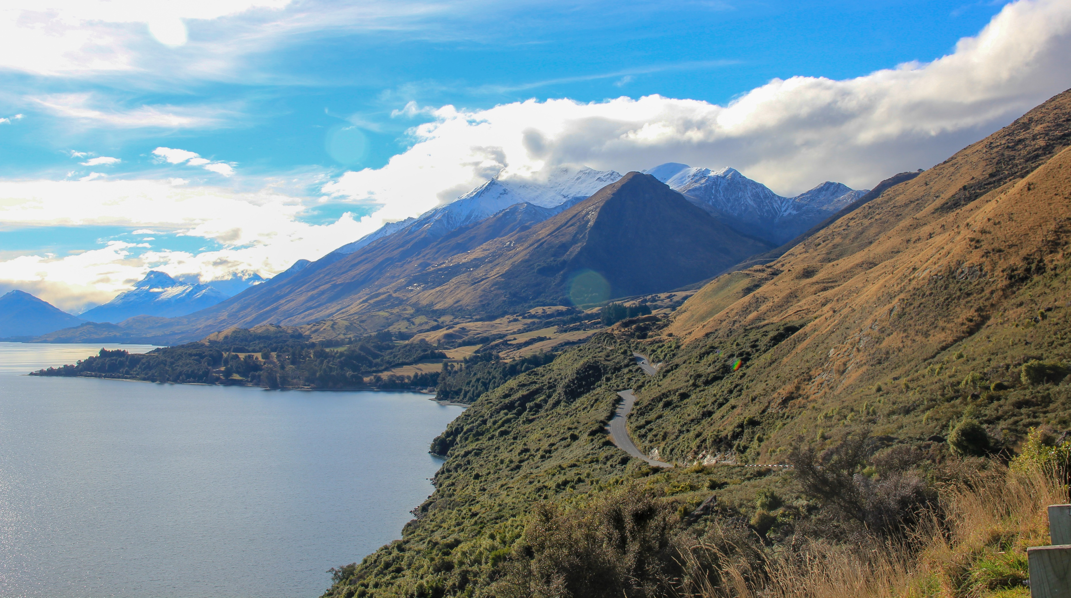
Plan your perfect view.

Slide 13
What is the foundation of Perfect Time? React, Firebase and Redux
React Web Application
Deployed on Google Firebase
NoSQL-database running on Firebase
Components synchronized with Redux

Slide 14
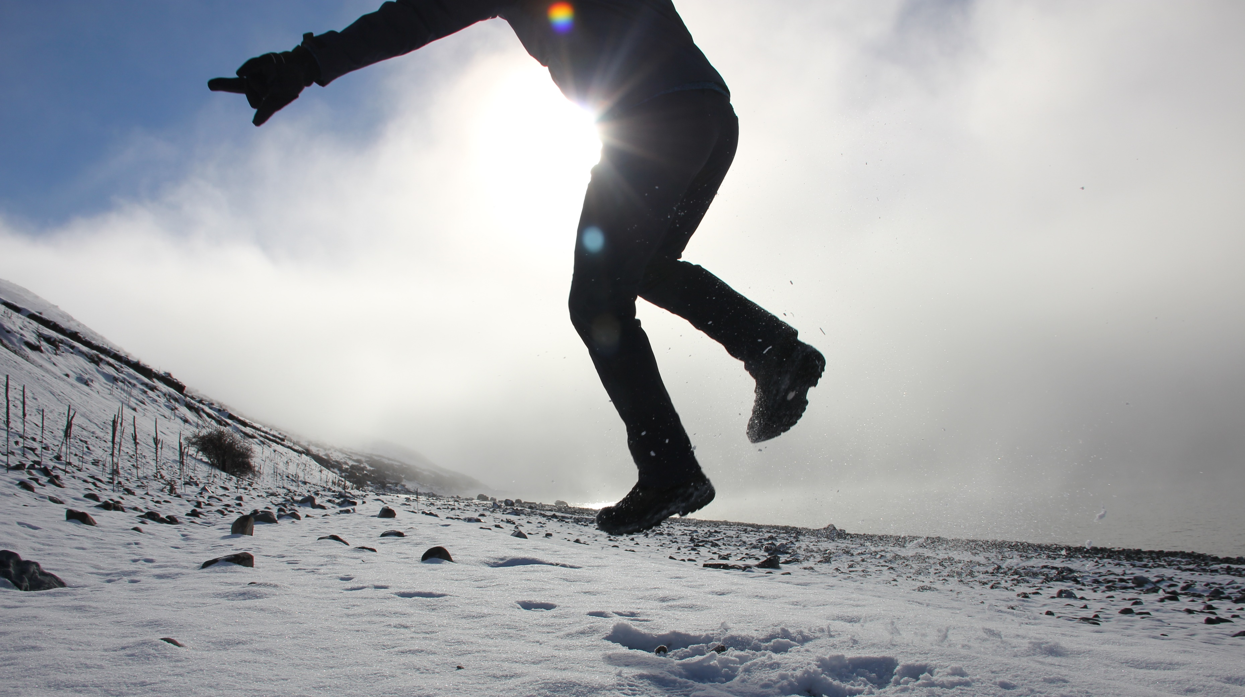
Find the place that makes your heart jump. Plan today.
Notes:
Tim

Slide 15
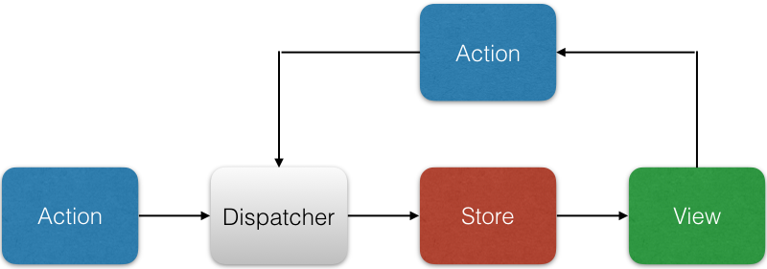
How was Perfect Time designed? React >> Flux architecture

Slide 16
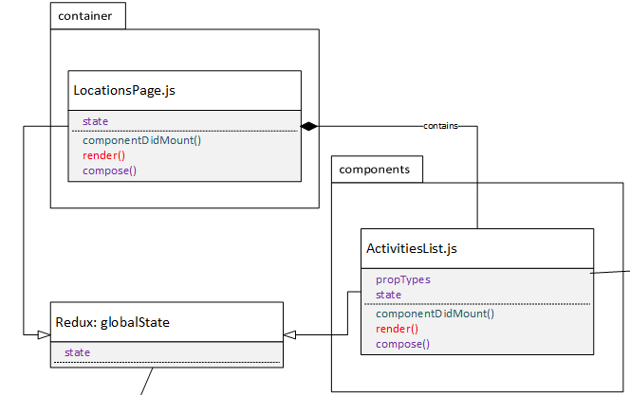
How was Perfect Time designed? Components

Slide 17
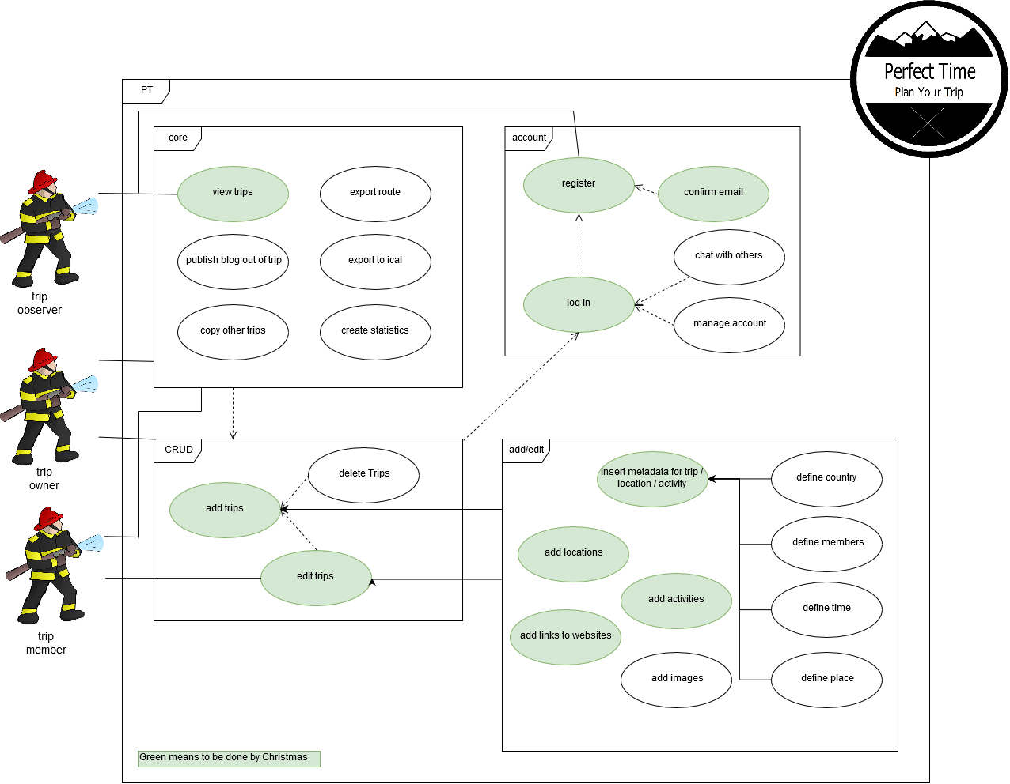
How was Perfect Time designed? Use Cases

Slide 18
How was Perfect Time designed? Use Cases

Slide 19
How was Perfect Time designed? Use Cases

Slide 20
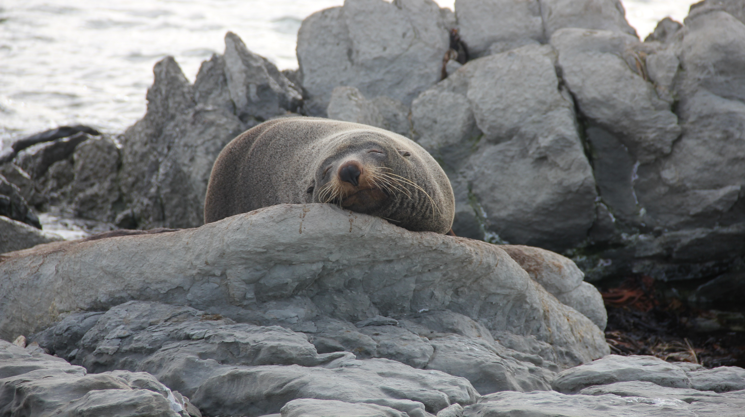
Learn chilling from the pros.
Add the “activity“ today.
Notes:
Lea

Slide 21
How is quality promoted and enforced? Merge Requests, Unit testing and Cucumber
Simple Rule: Merge through pull requests and test before you merge.
We create unit tests to test individual components.
We use Cucumber JS and TestCafe to test the whole application.
TODO: INSERT SCREENSHOT OF RUNNING TEST

Slide 22
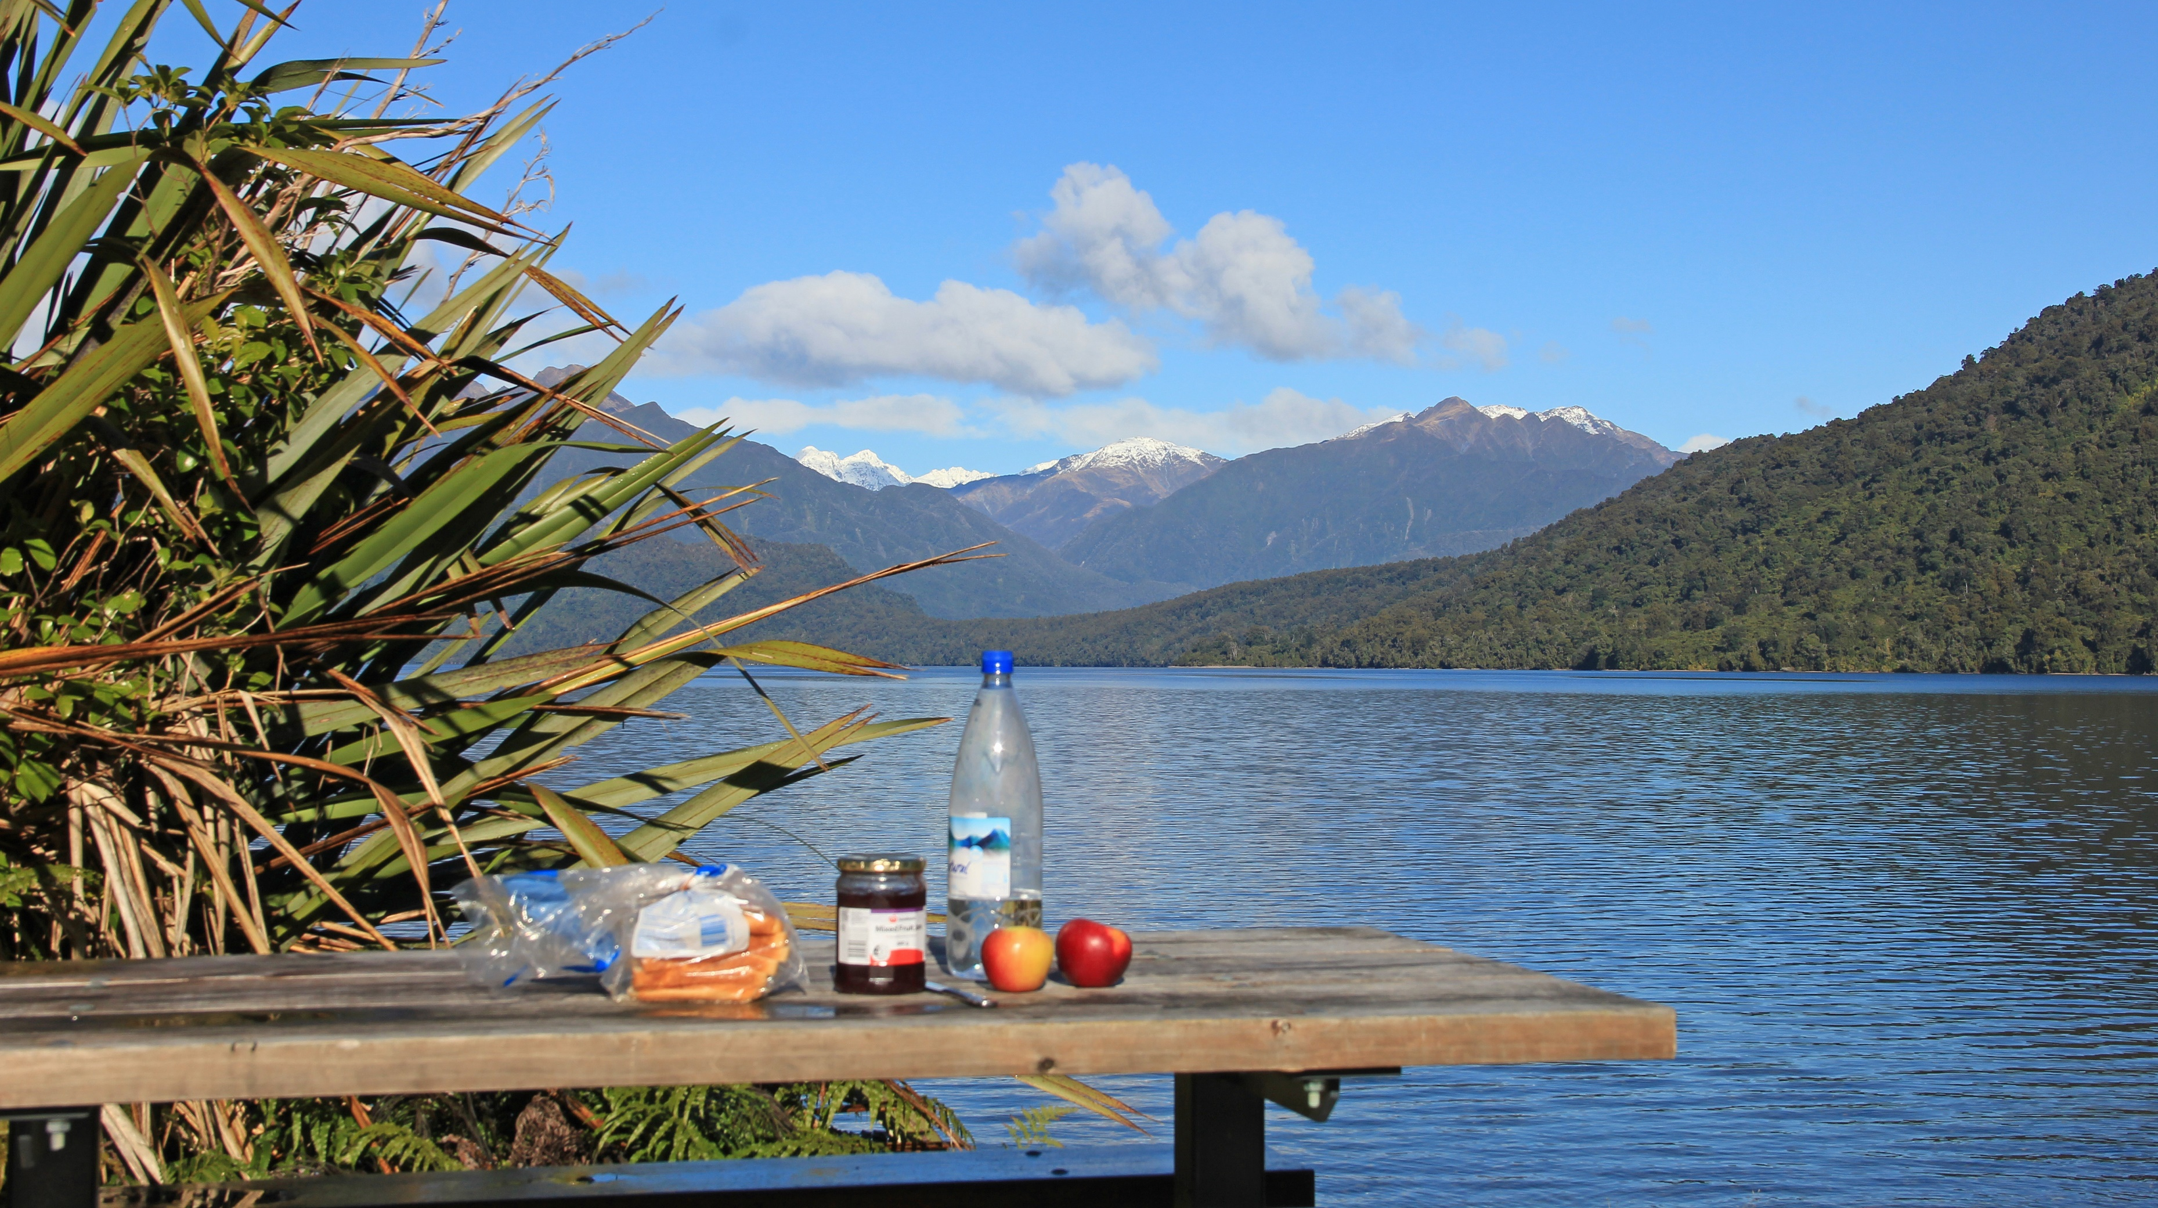
Surprise your loved one with the best date ever.
Plan it now.

Slide 23
What is the current state of the project? Live demonstration

Slide 24
What is the current state of the project? Things that are finished
Running application and database integration
View (all) locations
Add, Edit and View Location
Add, Edit and View Activity
Frame

Slide 25
What is the current state of the project? Things that are yet to come
User management
Security between accounts
Manage trips
Turn trip into a blog
Upload pictures and videos
Export / Import trip
Export to ical

Slide 26
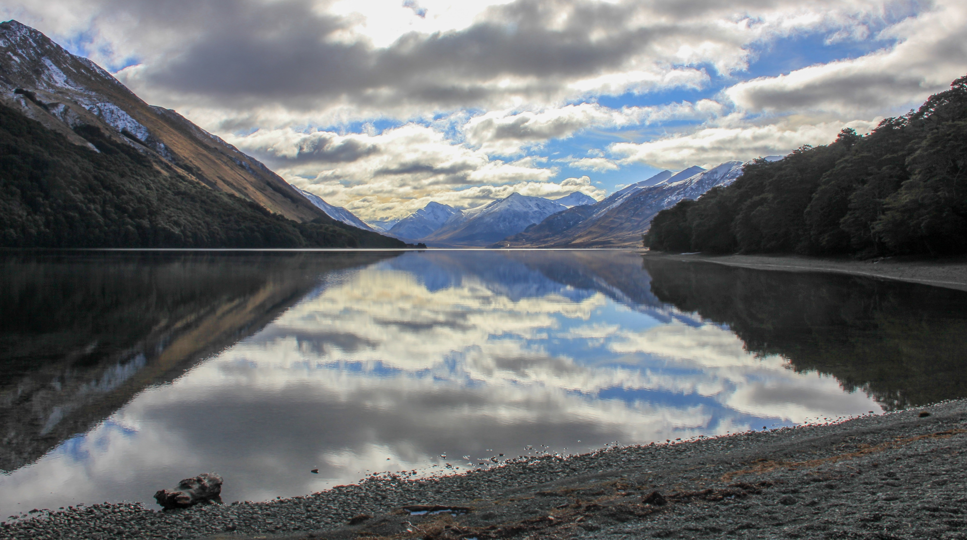
Shoot the perfect picture.
Add the location now.

Slide 27
Thank you for your attention!
And have a Perfect Time.

Slide 28
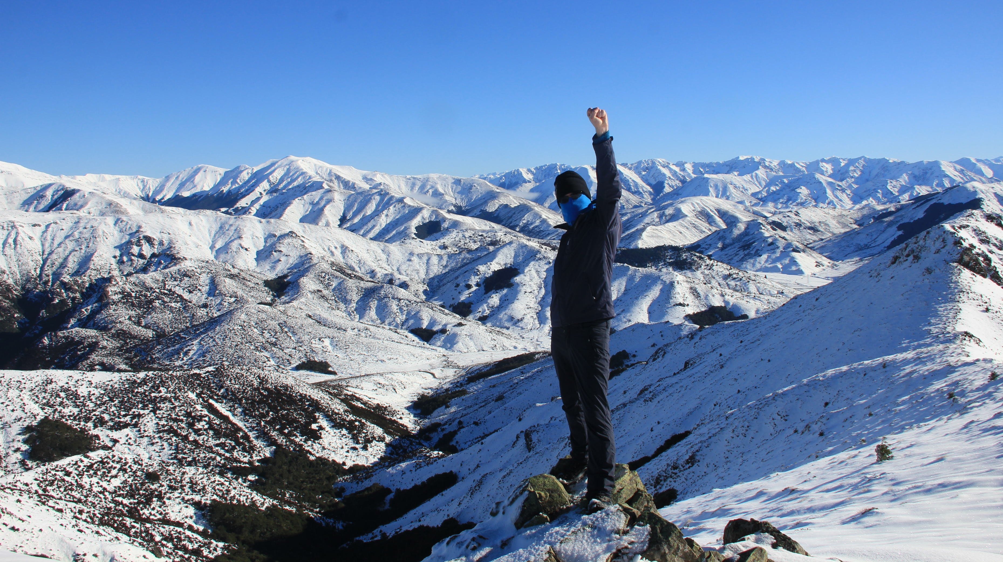
Make every time a Perfect Time.
Plan Your Trip today!

Slide 29
Make every time a Perfect Time.
Plan Your Trip today!

